Slide 1
GUIDELINES for employees & volunteers
This is for Employees and Volunteers
working for Climb the Mountain

Slide 2

Welcome to Climb!
Have a fun and educational experience
Instruction
Community connections
Great practice
Let’s make it happen! . . .

Slide 3
As an employee or volunteer . . .
you may not consume nor be under the influence of, nor be near alcohol or illicit drugs . . .
On campus, at lunch, immediately before, nor immediately after work hours
  You should immediately leave any area with such items except if at a restaurant
Even if you are over 21
We want and expect a professional program, one that is safe, and one we can be proud to show to administrators.

Slide 4


If you Socialize, Make it fun and safe
After hours—you are not under the supervision of Climb . . .
Still, we encourage you to not use illicit drugs nor excessive consumption of alcohol
If you are in a situation where
people are becoming intoxicated,
we strongly encourage you to leave.
If you setup social get-togethers . . . Do so without alcohol or with very low
alcohol consumption and never illicit drugs.
Juice! Healthy Snacks!

Slide 5

Be on time
Follow the schedule
As much as is possible, please use the bathroom, take your breaks before instruction starts so you are ready to go.
No Smoking—inside and outside—smoke only off campus.
Start each session on schedule
If you are late—your pay may be docked.

Slide 6
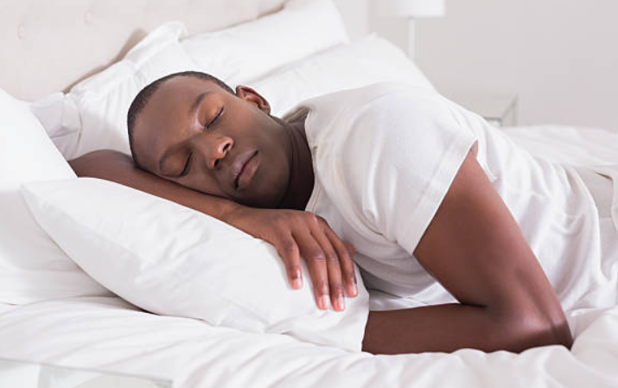
Be Rested and Ready . . .
You need to be well rested.
Participants should not have to deal with a cranky lab leader because you chose to stay up until 4 in the morning.
Further, when you don’t get rest, you get sick and then you can’t do your job.

Slide 7
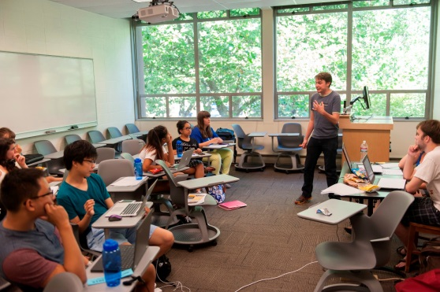
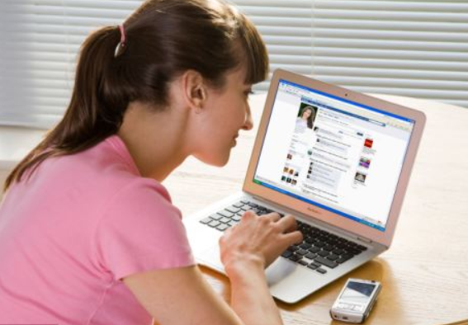
Keep students on task . . .
Make them feel engaged.
Let them have some fun too.
Don’t have breaks over and over again.
Don’t tune out while you check your phone or Facebook. : (
Respect needs for the bathroom and emergencies.

Slide 8
Treat Classrooms with respect
Show respect to the School and Staff.
Avoid loud noises (interrupts others).
Be courteous and cooperative with security.
Do not take nor move tech items (keyboards, mice, power cords, etc.) from rooms.

Slide 9
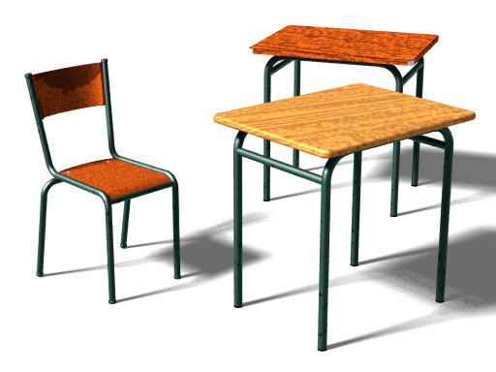
Treat Classrooms with respect
Move furniture?
  Do it only if permitted by our host
  Do it carefully
  Return it in place at the end of your lab/round
Use ONLY dry markers for the whiteboards (other markers damage the boards).
Room clean at the end of your session?
Make it so.

Slide 10

Check your Email . . .
At least 3 times a day
If you have a need, email Jim
  Jim gets many requests and having an email assures he gets your request taken care of . . .

Slide 11


Keep your Facebook etc. professional and/or private . . .
All of your social sites
Facebook Twitter, Instagram, whatever the latest is . . .
If your info is available to the public . . .
  Remove depictions/statements of drinking, explicit sexual activity, swearing, harsh attacks on those you disagree with, etc.
  AND/OR
  Make your Facebook inaccessible to students and consider the harm you can do to yourself by allowing others such as fellow colleagues and potential employers to see your posts that may be deemed offensive, inappropriate, etc.

Slide 12
Being Professional
Some of you are young; you are close in age to the students
But . . .
You are now an _employee_ not a student
They are different roles.

Slide 13
Step up to that role
You are now offering advise and instruction
You now have employee responsibilities
You have a duty to the students and staff around you
Be an adult—a friendly professional, not a friend of the students.

Slide 14
Interact with others professionally
Avoid touching students and staff unless explicitly asked (e.g. a handshake or short hug) and keep it caring-professional.
Don’t ask students and staff about their sexual/romantic experiences
No showing sexualized pictures
Avoid looking at individual students and staff for long periods of time.

Slide 15
Avoid being in an academic room with a student alone
Keep doors open to all practices, lectures, and lab sessions
See a secluded area? Stay away from there with others.
Rooms and areas will be checked by our staff periodically.
You may not be in a residence room with students.

Slide 16
Email/text/electronic and any kind of communication with students should never imply anything other than a teacher to student educational, professional relationship
Do not swear
  find new words to express yourself.

Slide 17
Avoid interacting with a particular student too frequently
Engage students in a group only
Have concerns about a student? A staff member? Immediately share your concern with Jim, Angie, Zach, or Tiffany.
Student shares a concern with you? Show support for the student and immediately share that concern with Jim, Angie, Zach, or Tiffany.

Slide 18
Be inclusive
Encourage everyone to participate.
Be open to differences
  Lesbian-Gay-Straight-Bi-Queer
  Black-White-Latino-Asian-Biracial-
  Multiracial, etc.
  Men-Women-Transgender-Androgynous-Genderqueer-etc.
  Republican-Democrat-Libertarian-etc.
  Christian, Agnostic, Catholic, Mormon (LDS), Jewish, Wicca, Muslim, etc.
  Disabilities--diagnosed or otherwise
  Military service
  Other identities
  Treat every student,
  coach, and judge with respect.

Slide 19
It is about respecting each other
Participants including students, judges, and coaches:
  should express their opinions about issues.
  should not attack groups of people.
  should not attack other individuals.
Argue about ideas—not disrespect toward people.

Slide 20
As an employee or volunteer . . .
judges, coaches, students, observers look up to you.
judges, coaches, speakers, and debaters are going to emulate you.

Slide 21
Be the judge-coach people talk about as . . .
“Yea, Elda rocks; helped me out a lot with that decision.”
“I respect him a lot. He can explain T and theory debates like nobody’s business and he reached out to younger debaters and made them feel included.”
“She’s wicked smart but also really, really nice—super helpful judge especially for Interp.”

Slide 22

As a lecturer Pt 1 . . .
You are expected to include all participants
Make _everyone_ feel included
Christians, lesbians, white straight males, conservatives, people of color, etc.
EVERYONE.

Slide 23
As a lecturer Pt 2 . . .
Let’s make students of all genders feel part of our work (trans, queer, androgynous, etc.)
Intros in lab: Ask students for their names, speech/debate interests, pronoun they wish to be referred as (but do not require it)—and use that pronoun.
Don’t single out a student as a representative of a group.
Don’t assume everyone is white/middle class/straight/liberal etc.

Slide 24
As a lecturer Pt 3 . . .
Give each and every student about equal numbers of questions, opportunities to practice, positive and constructive feedback, etc.
Use _diverse_ examples in your lectures—differing genders, races, religions, etc. without being gratuitous
INCLUDE EVERYONE.

Slide 25
As a lab leader, lecturer, and judge watching practices . . .
You have an obligation to assure a comfortable environment
For _all_ participants
First Time Speeches/Practices? Ask everyone to out-loud affirm their support for each other.

Slide 26
At each and every moment . . .
Be thinking—how can I include people?
Reach out to include people
Be sensitive to others’ feelings
Encourage improvement—don’t harshly criticize
If someone raises a concern e.g. I’m being left out—try to address it immediately and it is best to inform Jim, Angie, Zach, or Tiffany even if it is minor.

Slide 27
If You’re Being Harassed
  PLEASE . . .
  Tell the harasser that his/her/their actions are unwanted, offensive, make you uncomfortable, and must STOP
  Share with Jim, Angie, Zach, or Tiffany that you were harassed
  Write a record of what happened:
      When and where the incident occurred, who was involved, what happened, why you think you/participant were treated in a discriminatory manner, who witnessed the incident.

Slide 28
So you don’t harass others . . .
Keep compliments casual and avoid personal issues/private issues.
Avoid jokes, words, phrases, obscene gestures with sexual meanings and definitely not sexist, racist, etc. jokes.
Keep your hands to yourself. Avoid touching.
Don’t talk about sex during labs and practice sessions.
Don’t assume that a friendly person is interested in a sexual/romantic relationship with you. Assume only that friendly people are friendly.

Slide 29
So you don’t harass others . . .
Respect the personal space of others and don’t gossip about others.
Don’t focus attention on one individual (e.g. gifts, lots of practice with just one person, following someone around, etc.).
Don’t make jokes or comments that disrespect or belittle a person. Don’t bully people.
Ask if something you do or say is being perceived as offensive or unwelcome. If you don’t get a very clear confirmation your actions are okay, stop the behavior.
Don’t interpret someone's silence as consent. Look for other nonverbal signals.

Slide 30
If you see or hear about harassment . . .
Bullying, mistreatment of others, harassment, child abuse--these need to be addressed
Whether it is done by or affects a
  Coach
  Judge
  Student
  Observer
  Anyone participating or attending the session or just in our classroom or housing areas . . .

Slide 31
If you see or hear about harassment . . .
Stop it if possible
Say “Stop it” or “Hey, let’s move on to . . .” and then as soon as possible talk to the student(s) who are harassing and tell them to stop.
Share the information about it . . .
with Jim, Angie, Zach, or Tiffany
We’ll work to make things better.

Slide 32
Share the Information ASAP Pt 1
Don’t delay; communicate . . .
  “I don’t want to get someone in trouble”
  Our goal is to work out the problem in a constructive manner.
  “It wasn’t that big of a deal”
  It might have been; we need to make sure.
  “People need to get over their sensitivity”
  Please show support for people’s feelings; there may be a good reason they are sensitive to what happened.
  “I got it worked out”
  That’s great but we need to check and make sure.
  “I’m scared to report”
  Understood. We’re here to support you. Take that step and help make our community a safer place.

Slide 33
Share the Information ASAP Pt 2
Don’t delay; communicate . . .
  “The person isn’t really a debater/interper/speaker”
  It still affected someone during our session. Show support for all people, not just speech and debate community members.
  “I’m not a top ten judge; the person is. I don’t have the clout to share this information.”
  Yes, you do. Everyone participates at the Climb Session and everyone has a right to a safe, comfortable, supportive environment.
  As a Climb the Mountain employee or volunteer, you are required to try to stop bad behavior if you can and share information about any harassment, bullying, or hurtful behavior.
  We encourage others to do the same.

Slide 34
Sharing Information Means . . .
We’ll work to determine the best course of action
We are interested in solving the problem—not punishing individuals or groups
We are interested in educating people to treat each other well
We are interested in protecting people from harm
We’ll work to make things better.

Slide 35
If someone complains or is the subject of a complaint . . .
Don’t gossip
Don’t blame or criticize
If you have information to share, do so with Jim, Angie, Zach or Tiffany, not in public
If anything, provide support for those facing difficulty (without criticizing others).

Slide 36
Child abuse . . .
Provide support for the student involved.
Ask only neutral questions and avoid going into details—leave that to the experts and counselors.
It is imperative that you share with Jim, Angie, Zach, or Tiffany, and/or contact the police and child protective services . . .
  Even if the student asks you to keep it confidential. You must inform authorities.

Slide 37
Visitors
No visitors at the camp except parents dropping off or picking up students and partners/friends of staff.
Even partner/friend/parent visitors should always be in observable areas.

Slide 38
Respect Differing Political Beliefs
Don’t call Republicans, leftists, and any political view you disagree with stupid and other names.
Your students may support that political view and be very hurt.
Instead . . .
Give your opinion in a professional manner and _explicitly_ allow for differing opinions (eg “Anyone disagree?—different viewpoints are respected”).

Slide 39
What if a student makes an offensive argument?
Explain why the argument is offensive/unpersuasive.
Don’t call the student names nor tell them they are terrible.
If the student has made a threat or expressed hate toward a group of people or individuals, tell them to stop and tell Jim, Angie, Zach or Tiffany.
If the student slurred or disparaged a group of people—convince them to stop; if the student doesn’t stop, you should inform Jim, Angie, Zach or Tiffany.
Climb respects free speech but we also as much as we can want to assure a safe space for all participating.

Slide 40
Kids with issues . . .
Student just isn’t motivated . . .
Student is really shy . . .
Student is easily upset . . .
Don’t call out these students.
Work with them—figure out what works—look for moments of motivation, engagement, and calmness—repeat those moments.
Seek out help from Jim and other staff members.

Slide 41
No Gambling or Making Money off of Students
Enough said. : )

Slide 42
Dealing with Rule Violations
Treat Students with respect
Tell students directly and authoritatively to stop
Avoid threats of punishment
Contact Jim, Angie, Zach or Tiffany if it . . .
  Involves harassment, bullying, or danger
  The misbehavior is not getting solved.

Slide 43
Competition at the Camp . . .
Healthy competition is good—it encourages effort and initiative
Too much is not good; keep it balanced
You can and should be involved in helping students prepare cuttings, evidence, extemp articles, etc.
You should encourage but not force students to run/present certain arguments/pieces.

Slide 44

When a lecture or practice finishes . . .
Be sure to finish on time.
Don’t be late; keep us on schedule.
Give students time between sessions (5ish minutes typically).

Slide 45
Give students helpful feedback
Show respect; they’ve worked hard (respect them even if they haven’t).
Support their efforts to improve.
PROVIDE COMMENTS ABOUT WHAT THEY DID WELL:
YES “Your turns on the disad were really strong.”
YES “Your character has dimension and depth; the voice and gestures work really well.”
DON’T BE NEGATIVE, CRITICAL.

Slide 46
PROVIDE COMMENTS ABOUT HOW THEY SHOULD IMPROVE
YES “You need to work on your word economy.”
YES “Your piece needs some editing—parts of it aren’t as engaging as they need to be.”
NO “You talked on and on about their kritik. Not impressed.”
Say helpful things—not critical and mean things
Encourage Participation—encourage the students and others to pursue speech and debate.

Slide 47
And of course . . .
Don’t make a decision, comment, nor give speaker points based on . . .
    the race, class, gender, disabilities, etc. of the competitors rather than the arguments communicated in the debates
    That includes comments about clothing, hair, voice, mannerisms, etc. that are part of a person’s identity . . .
    UNLESS it was communicated as part of the arguments AND ALL of the participants heard and understand that.
Help students be the best they can be.

Slide 48
Emergencies/accidents
Serious at all? Call 911 then . . .
Report to Jim, Angie, Zach or Tiffany immediately
We can take students/staff to urgent care/hospital
We have a first aid kit in Jim’s office.

Slide 49

Make the Climb Session Great!
Treat each other with respect
That’s the Climb way!
Support each other
Share Information with Jim, Angie, Zach, or Tiffany when there is a problem
Promote good interactions
Make your lab leading, lectures, and judging a helpful benefit to . . .
students and coaches and your community!

Slide 50
Questions? Comments for improving this PowerPoint . . .
Email Jim at jim@climbthemountain.us

